Slide 1
Algorithms and Data Structures
Lecture XII
Simonas Šaltenis
Nykredit Center for Database Research
Aalborg University
simas@cs.auc.dk

Slide 2
This Lecture
Application of DFS: Topological Sort
Weighted Graphs
Minimum Spanning Trees
  Greedy Choice Theorem
  Kruskal’s Algorithm
  Prim’s Algorithm

Slide 3
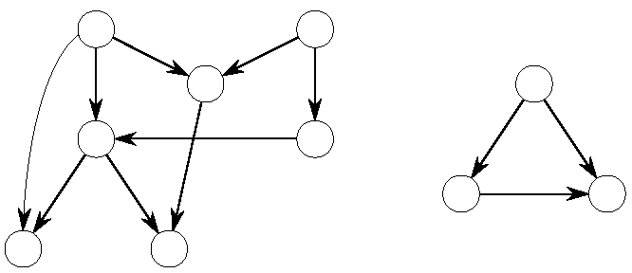
Directed Acyclic Graphs
A DAG is a directed graph with no cycles
Often used to indicate precedences among events, i.e., event a must happen before b
An example would be a parallel code execution
Total order can be introduced using Topological Sorting

Slide 4
DAG Theorem
A directed graph G is acyclic if and only if a DFS of G yields no back edges. Proof:
  suppose there is a back edge (u,v); v is an ancestor of u in DFS forest. Thus, there is a path from v to u in G and (u,v) completes the cycle
  suppose there is a cycle c; let v be the first vertex in c to be discovered and u is a predecessor of v in c.
    Upon discovering v the whole cycle from v to u is white
    We must visit all nodes reachable on this white path before return DFS-Visit(v), i.e., vertex u becomes a descendant of v
    Thus, (u,v) is a back edge
Thus, we can verify a DAG using DFS!

Slide 5
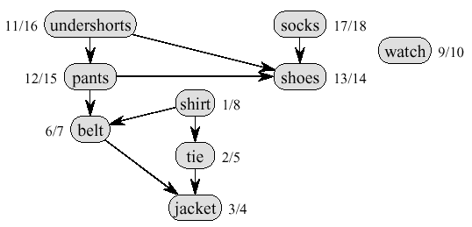

Topological Sort Example
Precedence relations: an edge from x to y means one must be done with x before one can do y
Intuition: can schedule task only when all of its subtasks have been scheduled

Slide 6
Topological Sort
Sorting of a directed acyclic graph (DAG)
A topological sort of a DAG is a linear ordering of all its vertices such that for any edge (u,v) in the DAG, u appears before v in the ordering
The following algorithm topologically sorts a DAG
The linked lists comprises a total ordering
Topological-Sort(G)
1) call DFS(G) to compute finishing times f[v] for each vertex v
2) as each vertex is finished, insert it onto the front of a linked list
3) return the linked list of vertices

Slide 7
Topological Sort
Running time
  depth-first search: O(V+E) time
  insert each of the |V| vertices to the front of the linked list: O(1) per insertion
Thus the total running time is O(V+E)

Slide 8
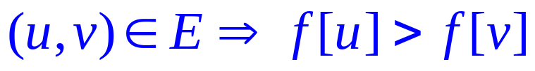
Topological Sort Correctness
Claim: for a DAG, an edge
When (u,v) explored, u is gray. We can distinguish three cases
  v = gray
  ⇒ (u,v) = back edge (cycle, contradiction)
  v = white
  ⇒ v becomes descendant of u
  ⇒ v will be finished before u
  ⇒ f[v] < f[u]
  v = black
  ⇒ v is already finished
  ⇒ f[v] < f[u]
The definition of topological sort is satisfied

Slide 9
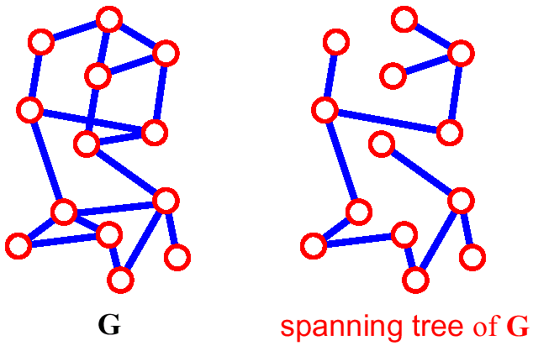
Spanning Tree
A spanning tree of G is a subgraph which
  is a tree
  contains all vertices of G

Slide 10
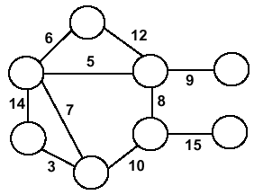
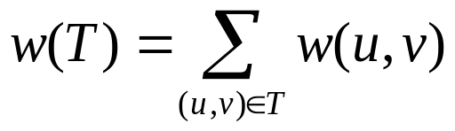
Minimum Spanning Trees
Undirected, connected graph G = (V,E)
Weight function W: E → R (assigning cost or length or other values to edges)
Spanning tree: tree that connects all the vertices (above?)
Minimum spanning tree: tree that connects all the vertices and minimizes

Slide 11
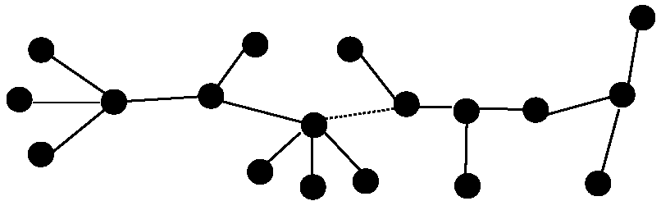
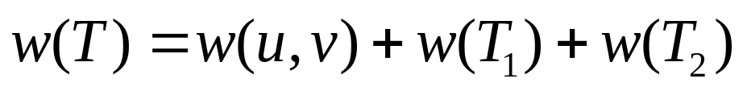
Optimal Substructure
T₂
MST T
Removing the edge (u,v) partitions T into T₁ and T₂
We claim that T₁ is the MST of G₁=(V₁,E₁), the subgraph of G induced by vertices in T₁
Also, T₂ is the MST of G₂
T₁

Slide 12
Greedy Choice
Greedy choice property: locally optimal (greedy) choice yields a globally optimal solution
Theorem
  Let G=(V, E), and let S ⊆ V and
  let (u,v) be min-weight edge in G connecting S to V – S
  Then (u,v) ∈ T – some MST of G

Slide 13
Greedy Choice (2)
Proof
  suppose (u,v) ∉ T
  look at path from u to v in T
  swap (x, y) – the first edge on path from u to v in T that crosses from S to V – S
  this improves T – contradiction (T supposed to be MST)
V-S
S
y
x
u
v

Slide 14
Generic MST Algorithm
Generic-MST(G, w)
1 A←∅ // Contains edges that belong to a MST
2 while A does not form a spanning tree do
3 Find an edge (u,v) that is safe for A
4 A←A∪{(u,v)}
5 return A
Safe edge – edge that does not destroy A’s property
MoreSpecific-MST(G, w)
1 A←∅ // Contains edges that belong to a MST
2 while A does not form a spanning tree do
3.1 Make a cut (S, V-S) of G that respects A
3.2 Take the min-weight edge (u,v) connecting S to V-S
4 A←A∪{(u,v)}
5 return A

Slide 15
Prim-Jarnik Algorithm
Vertex based algorithm
Grows one tree T, one vertex at a time
A cloud covering the portion of T already computed
Label the vertices v outside the cloud with key[v] – the minimum weigth of an edge connecting v to a vertex in the cloud, key[v] = ∞, if no such edge exists

Slide 16
Prim-Jarnik Algorithm (2)
MST-Prim(G,w,r)
01 Q ← V[G] // Q – vertices out of T
02 for each u ∈ Q
03 key[u] ← ∞
04 key[r] ← 0
05 π[r] ← NIL
06 while Q ≠ ∅ do
07 u ← ExtractMin(Q) // making u part of T
08 for each v ∈ Adj[u] do
09 if v ∈ Q and w(u,v) < key[v] then
10 π[v] ← u
11 key[v] ← w(u,v)
updating keys

Slide 17
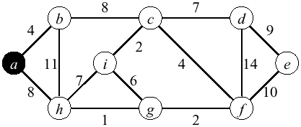
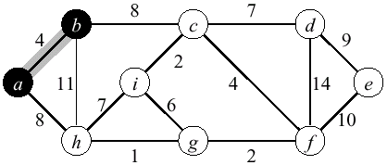
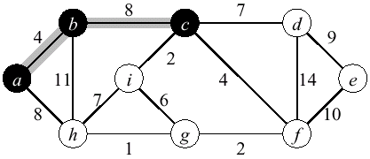
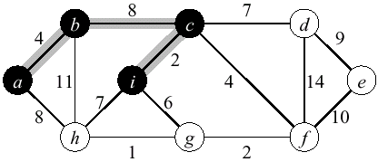
Prim Example

Slide 18
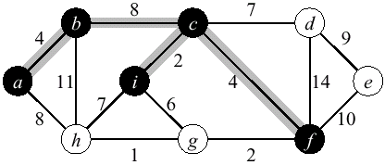
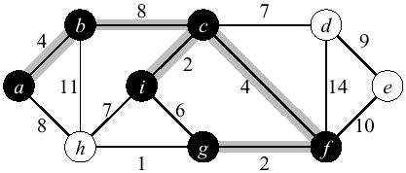
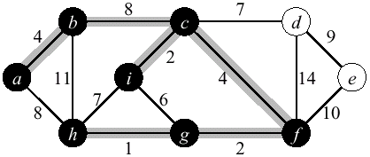
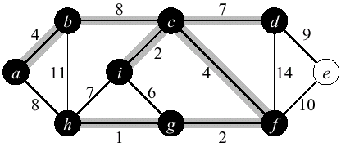
Prim Example (2)

Slide 19
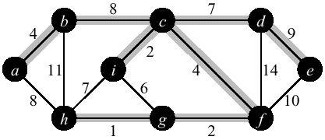
Prim Example (3)

Slide 20
Priority Queues
A priority queue is a data structure for maintaining a set S of elements, each with an associated value called key
We need PQ to support the following operations
  BuildPQ(S) – initializes PQ to contain elements of S
  ExtractMin(S) returns and removes the element of S with the smallest key
  ModifyKey(S,x,newkey) – changes the key of x in S
A binary heap can be used to implement a PQ
  BuildPQ – O(n)
  ExtractMin and ModifyKey – O(lg n)

Slide 21
Prim’s Running Time
Time = |V|T(ExtractMin) + O(E)T(ModifyKey)
Time = O(V lgV + E lgV) = O(E lgV)
Q | T(ExtractMin) | T(DecreaseKey) | Total
array | O(V) | O(1) | O(V ²)
binary heap | O(lg V) | O(lg V) | O(E lgV )
Fibonacci heap | O(lg V) | O(1) amortized | O(V lgV +E )

Slide 22
Kruskal's Algorithm
Edge based algorithm
Add the edges one at a time, in increasing weight order
The algorithm maintains A – a forest of trees. An edge is accepted it if connects vertices of distinct trees
We need an ADT that maintains a partition, i.e.,a collection of disjoint sets
  MakeSet(S,x): S ← S ∪ {{x}}
  Union(S_{i},S_{j}): S ← S – {S_{i},S_{j}} ∪ {S_{i} ∪ S_{j}}
  FindSet(S, x): returns unique S_{i} ∈ S, where x ∈ S_{i}

Slide 23
Kruskal's Algorithm
The algorithm keeps adding the cheapest edge that connects two trees of the forest
MST-Kruskal(G,w)
01 A ← ∅
02 for each vertex v ∈ V[G] do
03 Make-Set(v)
04 sort the edges of E by non-decreasing weight w
05 for each edge (u,v) ∈ E, in order by non-decreasing weight do
06 if Find-Set(u) ≠ Find-Set(v) then
07 A ← A ∪ {(u,v)}
08 Union(u,v)
09 return A

Slide 24
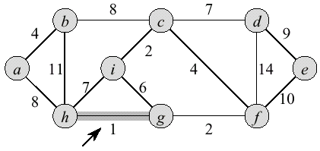
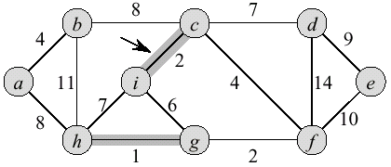
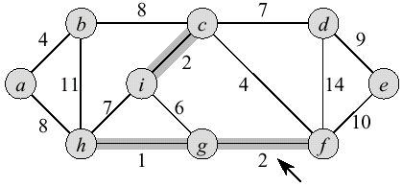
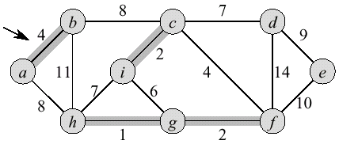
Kruskal Example

Slide 25
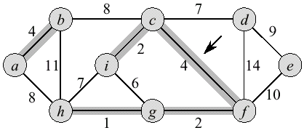
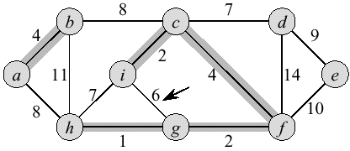
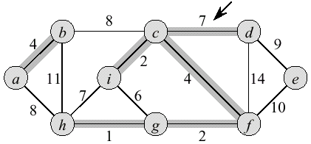
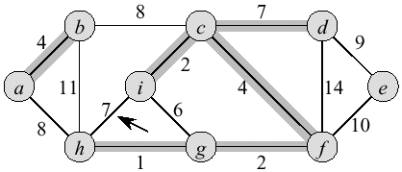
Kruskal Example (2)

Slide 26
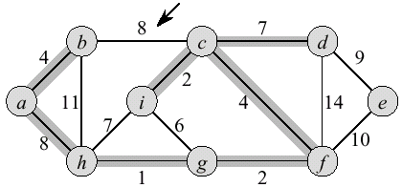
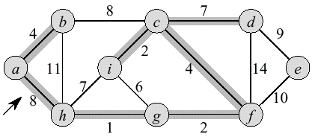
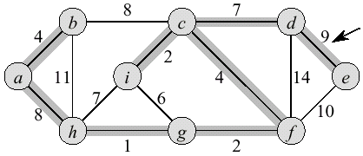
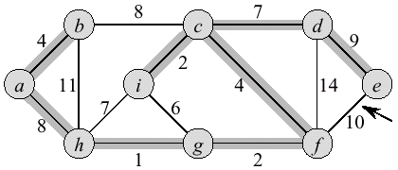
Kruskal Example (3)

Slide 27
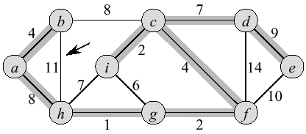
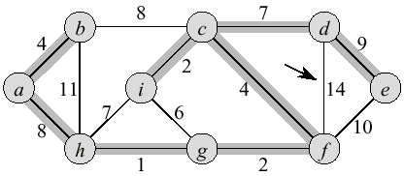
Kruskal Example (4)

Slide 28
Disjoint Sets as Lists
Each set – a list of elements identified by the first element, all elements in the list point to the first element
Union – add a smaller list to a larger one
FindSet: O(1), Union(u,v): O(min{|C(u)|, |C(v)|})
1
2
3
4
A
B
C
∅
∅
1
2
3
4
A
B
C
∅

Slide 29
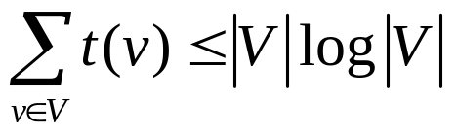
Kruskal Running Time
Initialization O(V) time
Sorting the edges Θ(E lg E) = Θ(E lg V) (why?)
O(E) calls to FindSet
Union costs
  Let t(v) – the number of times v is moved to a new cluster
  Each time a vertex is moved to a new cluster the size of the cluster containing the vertex at least doubles: t(v) ≤ log V
  Total time spent doing Union
Total time: O(E lg V)

Slide 30
Next Lecture
Shortest Paths in Weighted Graphs

